Slide 1
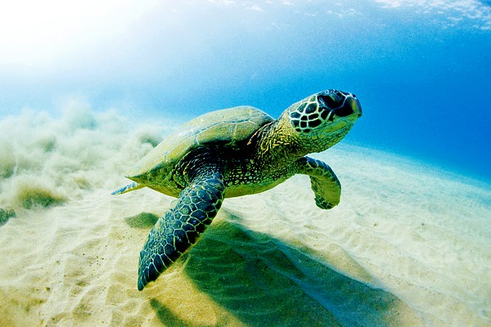
Swimmy Turtle introduced by Varun Iyer, Sheetal Jena, and Johncarlo Cerna

Slide 2
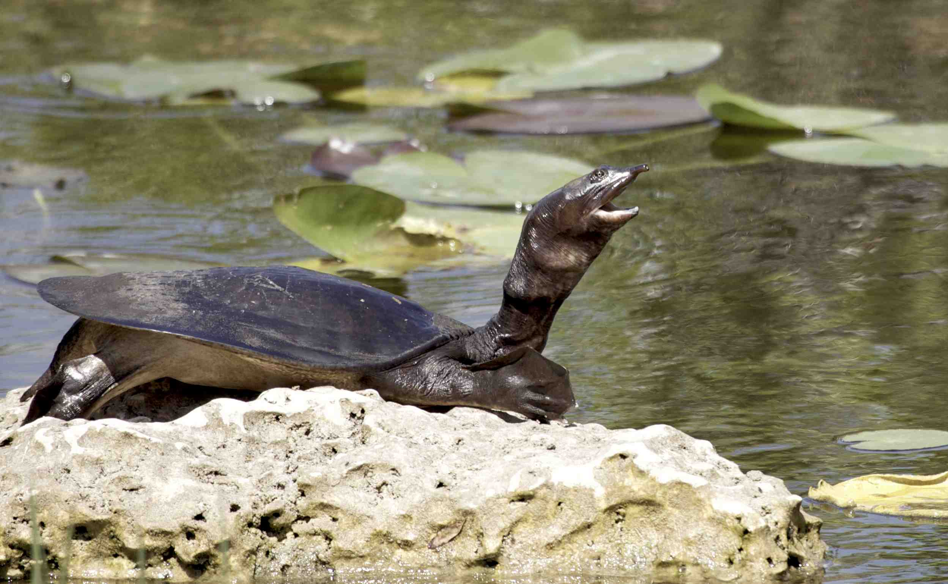
the app.
goal: people of all ages will be more interested and aware of the Everglades’
This app has an audience of all ages.
The app will have many parts to it:
- the game
- fun facts
- guide for the MODS’s Everglades exhibit
- a fun weekly survey

Slide 3
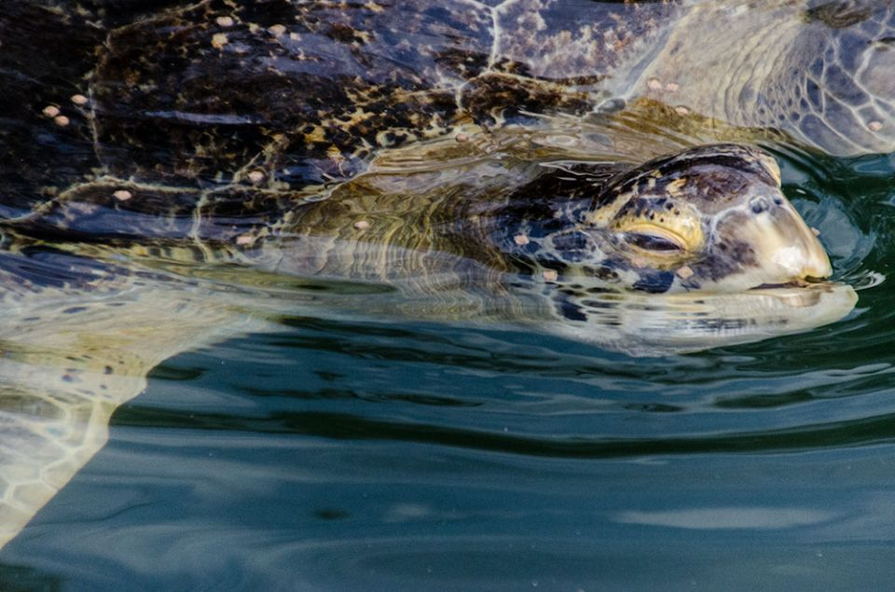
the game.
The game is a remake of the fun and famous game called Flappy Bird, so it will definitely bring in at least as much excitement and popularity.
It is important to know that Flappy Bird was a game that interested all age groups ranging from children to adults; therefore, Swimmy Turtle will also interest all age groups.
The game is very educational; the turtle swims through the water trying to survive in a polluted environment. It allows the player to understand how serious the problems facing the ecosystem are.

Slide 4
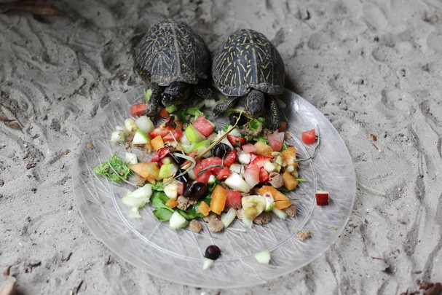
the fun facts.
The fun facts in this app are also educational and sure to make people of all ages fascinated and more aware of the problems that the Everglades face.
Parents will not struggle with not being well informed of the Everglades
Children will learn more, just as some adults will, and spread the word
Having more interest in the Everglades, people will get more involved in activities, such as donating money, to help the Everglades.
Adults will have more of a reason to visit MODS after having such interest in the ecosystem.

Slide 5
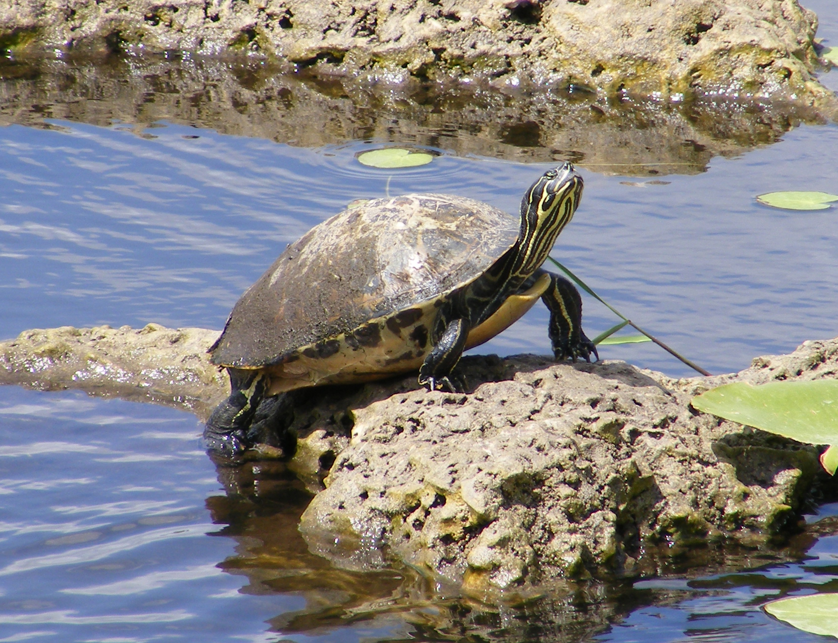
the exhibit, the map, and the survey.
The map and the exhibit part of the app will be informative
The exhibit screen will have information about the actual Everglades exhibit at the Museum of Discovery and Science
The map screen will just have two parts of the floor map of the exhibit. It will allow visitors to easily navigate their way through the exhibits to the Everglades exhibit.
There will be weekly surveys asking about the MODS exhibit and the problems facing the Everglades. This part of the app will be social.

Slide 6
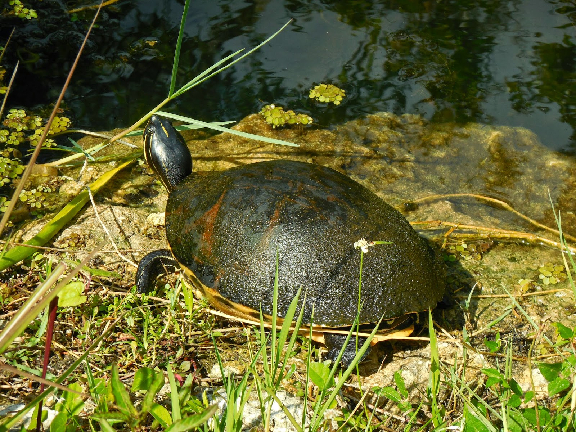
The Conclusion
Swimmy Turtle will not only increase awareness of the problems that the Everglades face, but users of the app can have fun at the same exact time.
The game is sure to be exciting and obsessive; it might even be more obsessive than Flappy Bird, since the game is environmental.
The fun facts will spread even more knowledge about the ecosystem.
The exhibit, map, and survey will all allow the user to become more familiar with MODS and there will be more visitors.

